Slide 1
Inova Asset Management
Portfólio

Slide 2
Projeto
Java
JSF
JPA
Hibernate
MS SQLSERVER

Slide 3
GITHUB
ssergiao/inova

Slide 4
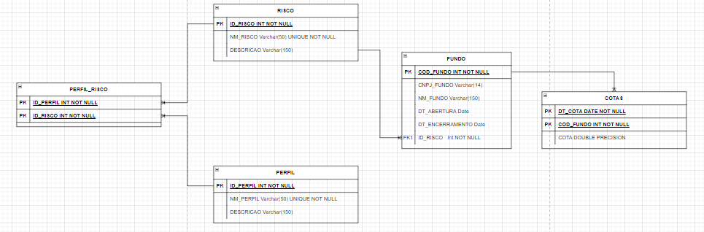
MODELO ER

Slide 5
DDR
CREATE TABLE bus3.FUNDO(
COD_FUNDO INT NOT NULL PRIMARY KEY,
CNPJ_FUNDO VARCHAR(14) ,
NM_FUNDO VARCHAR(150),
DT_ABERTURA DATE,
DT_ENCERRAMENTO DATE,
ID_RISCO INT NOT NULL,
FOREIGN KEY (ID_RISCO) REFERENCES bus3.RISCO(ID_RISCO),
INDEX IX_NM_FDO(NM_FUNDO),
INDEX IX_RSC_FDO(CNPJ_FUNDO)
)
GO
CREATE TABLE bus3.RISCO(
ID_RISCO INT NOT NULL PRIMARY KEY IDENTITY (1,1),
NM_RISCO VARCHAR(50) UNIQUE NOT NULL,
DESCRICAO VARCHAR(150)
)
GO
CREATE TABLE bus3.PERFIL (
ID_PERFIL INT NOT NULL PRIMARY KEY IDENTITY (1,1),
NM_PERFIL VARCHAR(50),
DESCRICAO VARCHAR (150)
)
GO

Slide 6
DDR
CREATE TABLE bus3.PERFIL_RISCO(
ID_PERFIL INT,
ID_RISCO INT,
PRIMARY KEY (ID_PERFIL , ID_RISCO),
FOREIGN KEY (ID_PERFIL)REFERENCES bus3.PERFIL(ID_PERFIL),
FOREIGN KEY (ID_RISCO) REFERENCES bus3.RISCO(ID_RISCO)
)
GO
-- RENTABILIDADE
CREATE VIEW bus3.RENTABILIDADE AS
(
SELECT
c.DT_COTA ,
c.COD_FUNDO ,
(C.COTA / LEAD(c.COTA , 22 , c.COTA) OVER(ORDER by COD_FUNDO ,DT_COTA DESC) -1) D30,
(C.COTA / LEAD(c.COTA , 66 , c.COTA) OVER(ORDER by COD_FUNDO ,DT_COTA DESC) -1) D90,
(C.COTA / LEAD(c.COTA , 126 ,c.COTA) OVER(ORDER by COD_FUNDO ,DT_COTA DESC) -1) D180,
(C.COTA / LEAD(c.COTA , 252 , c.COTA) OVER(ORDER by COD_FUNDO ,DT_COTA DESC) -1) D360
from bus3.COTAS c
)
CREATE TABLE bus3.COTAS (
DT_COTA DATE,
COD_FUNDO INT,
COTA DOUBLE PRECISION,
PRIMARY KEY (DT_COTA , COD_FUNDO),
FOREIGN KEY (COD_FUNDO) REFERENCES bus3.FUNDO(COD_FUNDO)
)
GO

Slide 7
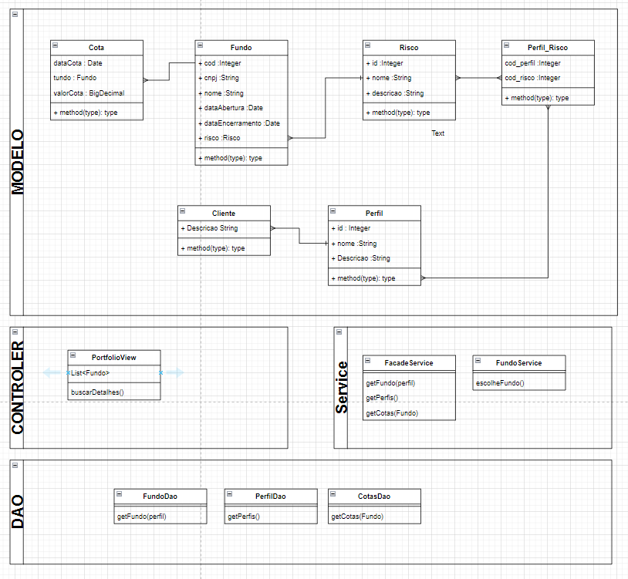
DIAGRAMA CLASSES

Slide 8
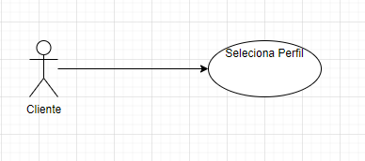
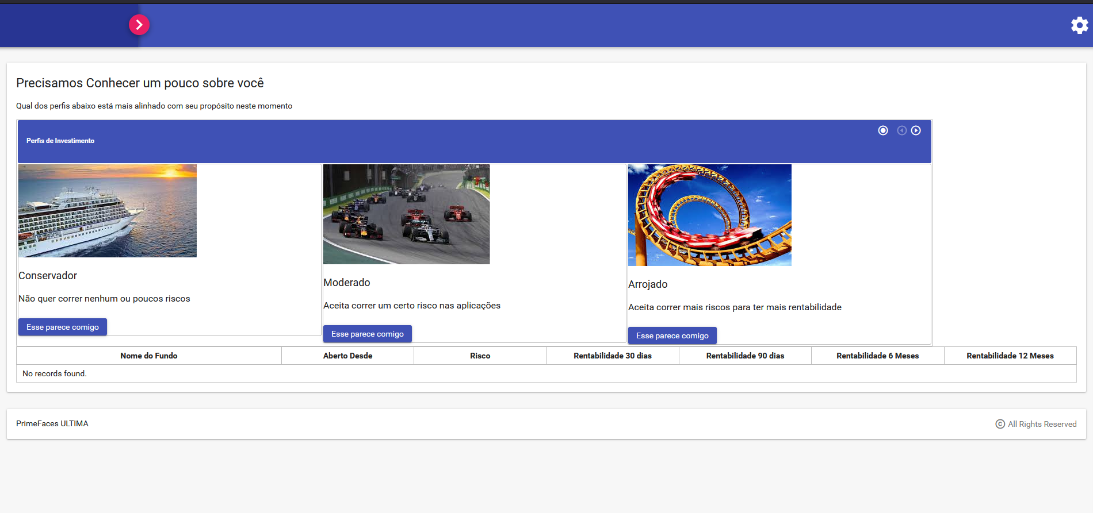
Tela Inicial

Slide 9
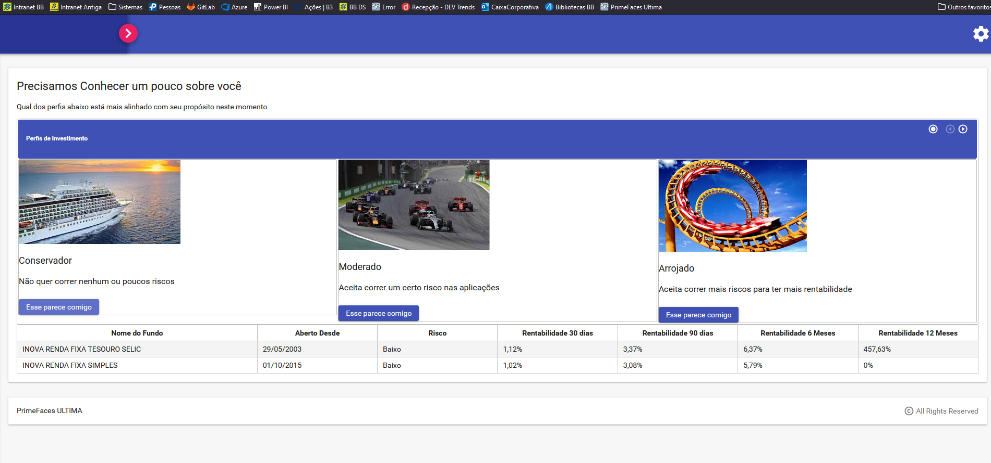
Simulação Conservador

Slide 10
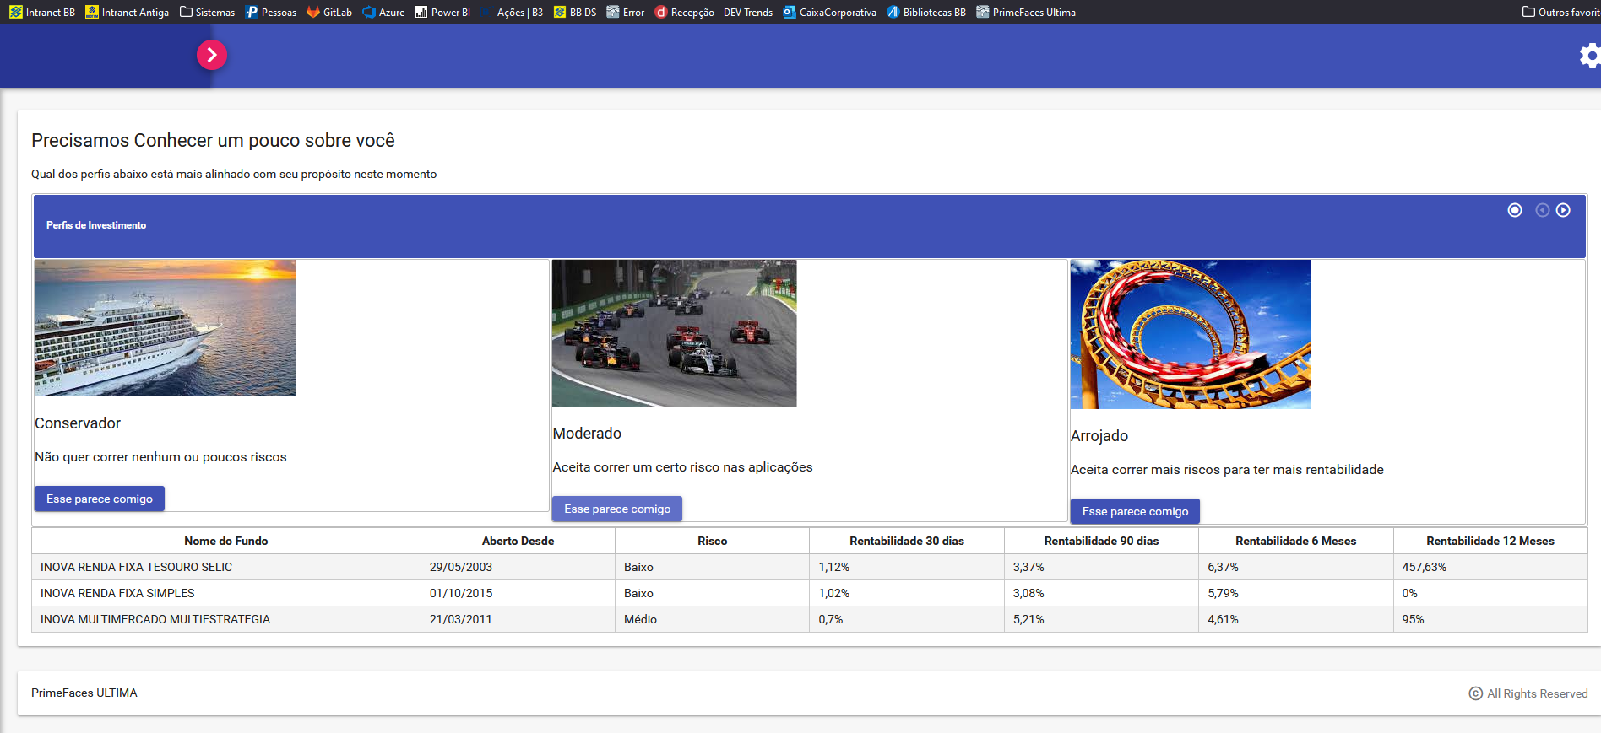
Simulação Moderado

Slide 11
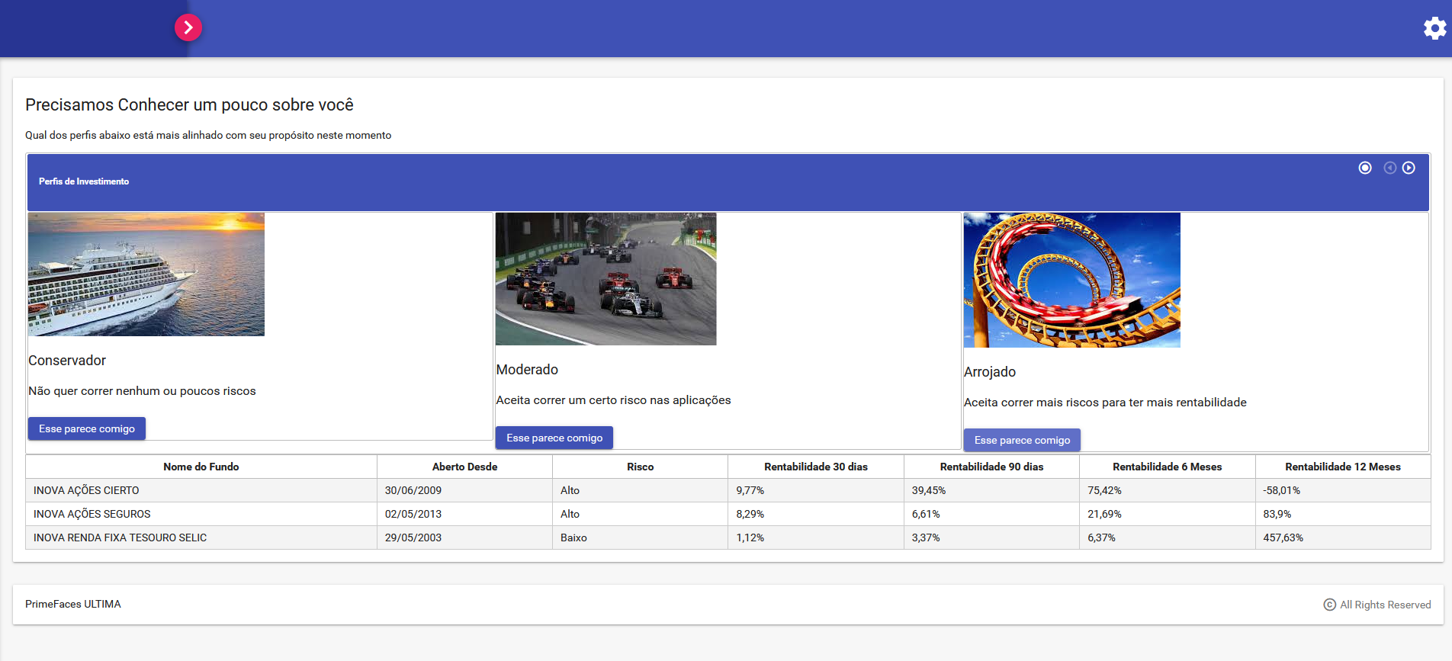
Simulação Arrojado

